Slide 1

Linear Functions
Algebra 2
Chapter 0

Slide 2
This Slideshow was developed to accompany the textbook
  Big Ideas Algebra 2
  By Larson, R., Boswell
  2022 K12 (National Geographic/Cengage)
Some examples and diagrams are taken from the textbook.
Slides created by
Richard Wright, Andrews Academy
rwright@andrews.edu

Slide 3
0-01 Solve Linear Equations and Inequalities
Objectives:
Solve linear equations.
Solve linear inequalities.
Solve a linear formula for a variable.

Slide 4


0-01 Solve Linear Equations and Inequalities
Golden Rule
Do unto others as you would like them to do unto you.
Jesus
Golden Rule of Algebra
Do unto one side of the equation as you have done unto the other side.
This Photo by Unknown Author is licensed under CC BY-NC-ND

Slide 5
0-01 Solve Linear Equations and Inequalities
General way to solve linear equations
  Get the variables all on one side
  Get everything away from the variables
Always follow the Golden Rule!!!

Slide 6


0-01 Solve Linear Equations and Inequalities
Solve $3x+6=0$
Solve $2\left(x+1\right)=5x$
Notes:
$$3x+6=0$$
$$3x=−6$$
$$x=−2$$
$$2\left(x+1\right)=5x$$
$$2x+2=5x$$
$$2=3x$$
$$\frac{2}{3}=x$$

Slide 7


0-01 Solve Linear Equations and Inequalities
Solve $4\left(x+5\right)≥16$
Solve $−2x+5<17−x$
Notes:
$$4\left(x+5\right)≥16$$
$$x+5≥4$$
$$x≥−1$$
$$−2x+5<17−x$$
$$−x+5<17$$
$$−x<12$$
$$x>−12$$

Slide 8


0-01 Solve Linear Equations and Inequalities
Solve for y: $2x+5y=12$
Solve for h: $3rh+5h=7$
Notes:
$$2x+5y=12$$
$$5y=12−2x$$
$$y=\frac{12−2x}{5}$$
$$3rh+5h=7$$
$$h\left(3r+5\right)=7$$
$$h=\frac{7}{3r+5}$$

Slide 9
0-01 Solve Linear Equations and Inequalities
A real estate agent’s base salary is $22,000 per year. The agent earns a 4% commission on total sales. How much must the agent sell to earn $60,000 in one year?
Notes:
$$Total money=base salary+commission percent·sales$$
$$60000=22000+0.04x$$
$$38000=0.04x$$
$$x=950,000$$

Slide 10
0-02 Use Problem Solving Strategies and Models
Objectives:
Use problem solving strategies to solve real-life problems.

Slide 11
0-02 Use Problem Solving Strategies and Models
The USA uses degrees Fahrenheit for temperature.
The rest of the world uses degrees Celsius.
That means we need a formula to convert between them.

Slide 12
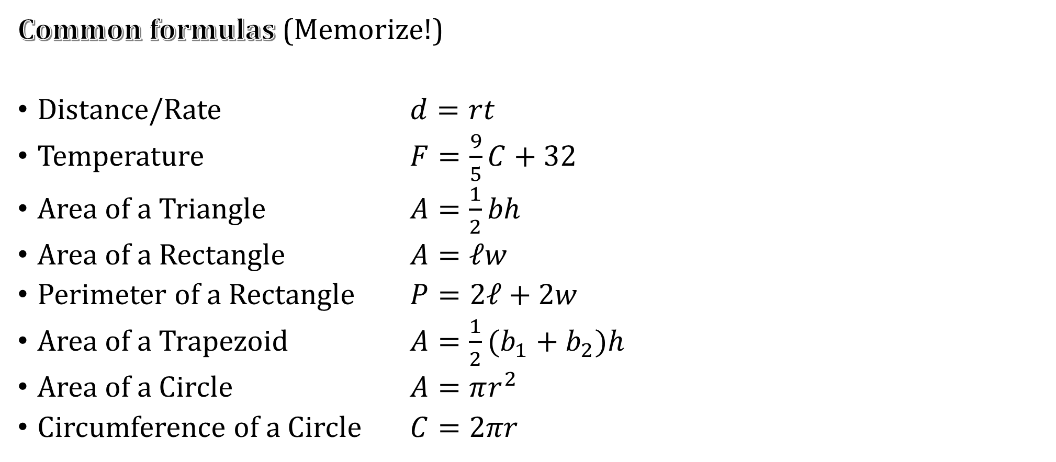
0-02 Use Problem Solving Strategies and Models
Common formulas (Memorize!)
Distance/Rate $d=rt$
Temperature $F=\frac{9}{5}C+32$
Area of a Triangle $A=\frac{1}{2}bh$
Area of a Rectangle $A=ℓw$
Perimeter of a Rectangle $P=2ℓ+2w$
Area of a Trapezoid $A=\frac{1}{2}(b_{1}+b_{2})h$
Area of a Circle $A=πr^{2}$
Circumference of a Circle $C=2πr$

Slide 13
0-02 Use Problem Solving Strategies and Models
Easiest to start by writing an equation in words. This is called a verbal model.
You probably think this way in your head already.
Ways to find a verbal model
Use a formula
Look for a pattern
Draw a diagram

Slide 14
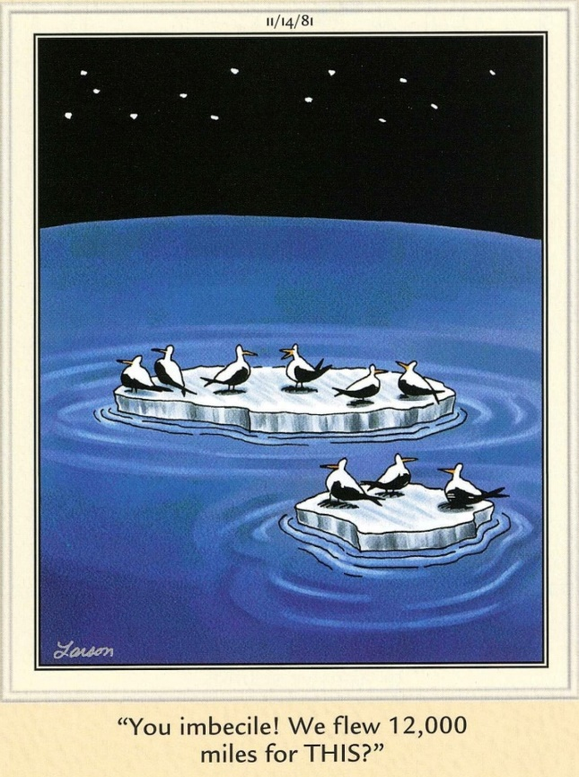
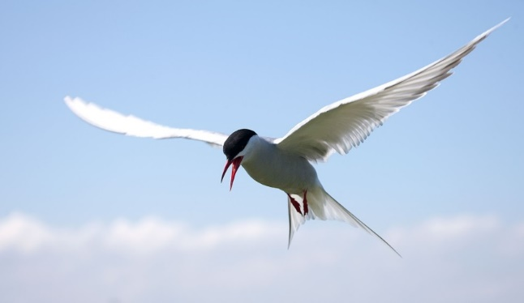
0-02 Use Problem Solving Strategies and Models
An artic tern flies an average speed of 16.7 miles per hour. How long will it take to fly from its winter grounds in Antarctica to its breeding grounds in Greenland, a distance of 12000 miles?
Notes:
$$Distance=rate·time$$
$$12000 mi=16.7\frac{mi}{hr}·t$$
$$t=719 hr=29.9 days$$

Slide 15
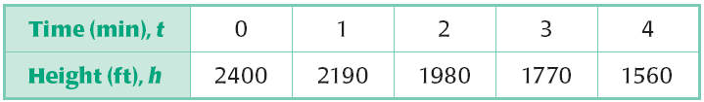
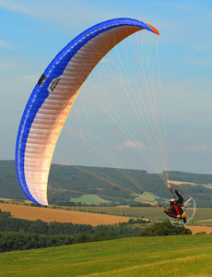
0-02 Use Problem Solving Strategies and Models
PARAMOTORING: The table shows the height h of a paramotorist after t minutes. Find the height of the paramotorist after 8 minutes.
Notes:
Subtracting consecutive heights shows that the paramotorist is losing 210 ft per min.
$$Height=initial height−rate·time$$
$$h=2400 ft−210\frac{ft}{min}·8 min$$
$$h=720 ft$$

Slide 16
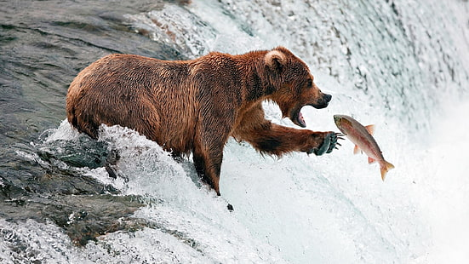
0-02 Use Problem Solving Strategies and Models
A bear walks 10 miles towards the west. Then it turns around and walks back east for 2 miles to try to catch a fish. After lunch it walks 5 more miles west until it finds a place to sleep. How far is the bear’s sleeping location from its starting position?
Notes:
Draw a diagram (west is negative)
$$−10 mi.+2 mi.−5 mi. =−13 mi.$$
13 miles to the west

Slide 17
0-03 Solve Absolute Value Equations and Inequalities
Objectives:
Solve absolute value equations.
Solve absolute value inequalities.

Slide 18
0-03 Solve Absolute Value Equations and Inequalities
Absolute Values
  Distance from origin to coordinate
  In one dimension, turns the number positive
| x | = b
  Distance between x and 0 is b
| x – k | = b
  Distance between x and k is b

Slide 19
0-03 Solve Absolute Value Equations and Inequalities
Steps to Solve Absolute Value Equations
Write two equations.
  One with the absolute value expression positive.
  One with the absolute value expression negative.
Solve each equation.
Check your solutions.

Slide 20


0-03 Solve Absolute Value Equations and Inequalities
Solve
  $\left|x−3\right|=10$
$\left|2x+5\right|=3x$
Notes:
$$x−3=10 or −(x−3)=10$$
$$x=13 or x−3=−10$$
$$x=13 or x=−7$$
$$2x+5=3x or −(2x+5)=3x$$
$$5=x or 2x+5=−3x$$
$$x=5 or 5=−5x$$
$$x=5 or x=−1 (−1 does not check)$$

Slide 21

0-03 Solve Absolute Value Equations and Inequalities
Solve
  $\left|4x−1\right|=2x+9$
Notes:
$$4x−1=2x+9 → 2x−1=9 → 2x=10 → x=5$$
$$OR$$
$$−\left(4x−1\right)=2x+9 → −4x+1=2x+9 → −6x+1=9 → −6x=8 → x=−\frac{8}{6}=−\frac{4}{3}$$

Slide 22
0-03 Solve Absolute Value Equations and Inequalities
Solve absolute value inequalities the same as equations
  Exception: write answer as compound inequality
Solve
  | 2x – 7 | > 1
  | 7 – x | ≤ 4
Notes:
$$2x−7>1 → 2x>8 → x>4$$
$$OR$$
$$−\left(2x−7\right)>1 → 2x−7<−1 → 2x<6 → x<3$$
$$x<3 or x>4$$
$$7−x≤4 → −x≤−3 → x≥3$$
$$OR$$
$$−\left(7−x\right)≤4 → 7−x≥−4 → −x≥−11 → x≤11$$
$$3≤x≤11$$

Slide 23
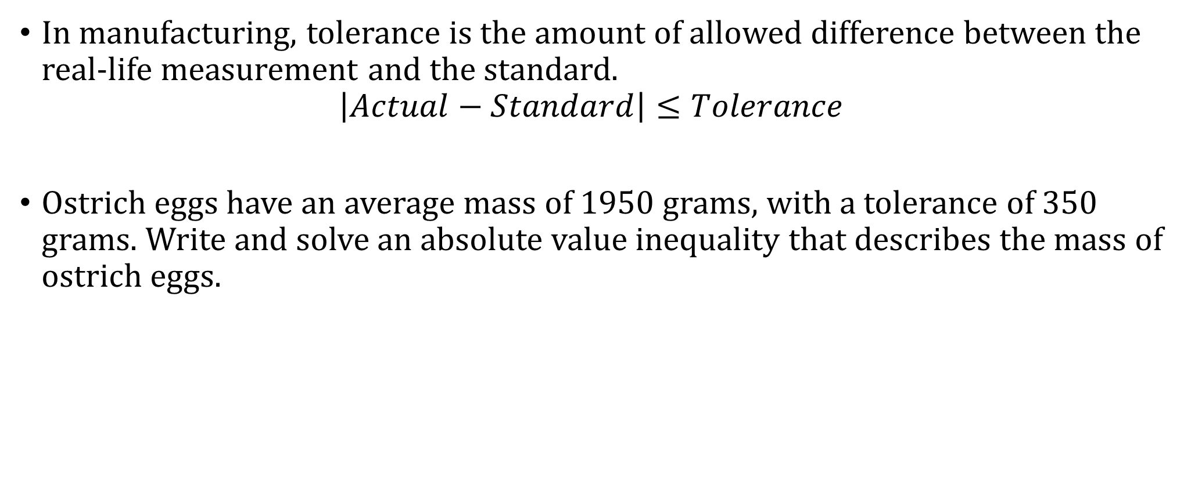
0-03 Solve Absolute Value Equations and Inequalities
In manufacturing, tolerance is the amount of allowed difference between the real-life measurement and the standard.
$$\left|Actual−Standard\right|≤Tolerance$$
Ostrich eggs have an average mass of 1950 grams, with a tolerance of 350 grams. Write and solve an absolute value inequality that describes the mass of ostrich eggs.
Notes:
The distance between the actual weight and the target weight should be less than or equal to the tolerance.
$$\left|x−1950\right|≤350$$
$$x−1950≤350 → x≤2300$$
$$OR$$
$$−\left(x−1950\right)≤350 → x−1950≥−350 → x≥1600$$
$$1600≤x≤2300$$

Slide 24
0-04 Find Slope and Write Equations of Lines
Objectives:
Find the slope of a line.
Determine whether lines are parallel, perpendicular, or neither using slopes.
Write the equation of a line.

Slide 25
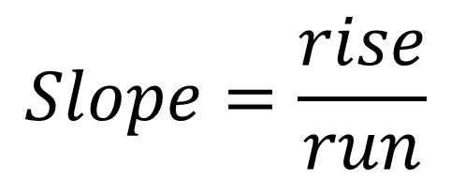
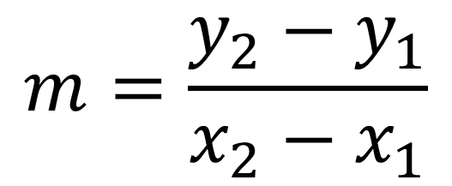
0-04 Find Slope and Write Equations of Lines
$$Slope=\frac{rise}{run}$$
(x₂, y₂)
rise
$$m=\frac{y_{2}−y_{1}}{x_{2}−x_{1}}$$
(x₁, y₁)
run
Slope is the rate of change

Slide 26
0-04 Find Slope and Write Equations of Lines
Positive Slope
  Rises
Zero Slope
  Horizontal
Negative Slope
  Falls
No Slope (Undefined)
  Vertical
0
+
–
No
There’s No Slope to stand on.

Slide 27
0-04 Find Slope and Write Equations of Lines
Find the slope of the line passing through the given points. Classify as rises, falls, horizontal, or vertical.
  (7, 3), (–1, 7)
  (7, 1), (7, −1)
Notes:
$m=\frac{y_{2}−y_{1}}{x_{2}−x_{1}}=\frac{8−3}{4−0}=\frac{5}{4}$; rises
$m=\frac{y_{2}−y_{1}}{x_{2}−x_{1}}=\frac{7−3}{−1−7}=\frac{4}{−8}=−\frac{1}{2}$; falls
$m=\frac{y_{2}−y_{1}}{x_{2}−x_{1}}=\frac{−1 – 1}{7 – 7}=−\frac{2}{0}=$ undefined; vertical

Slide 28
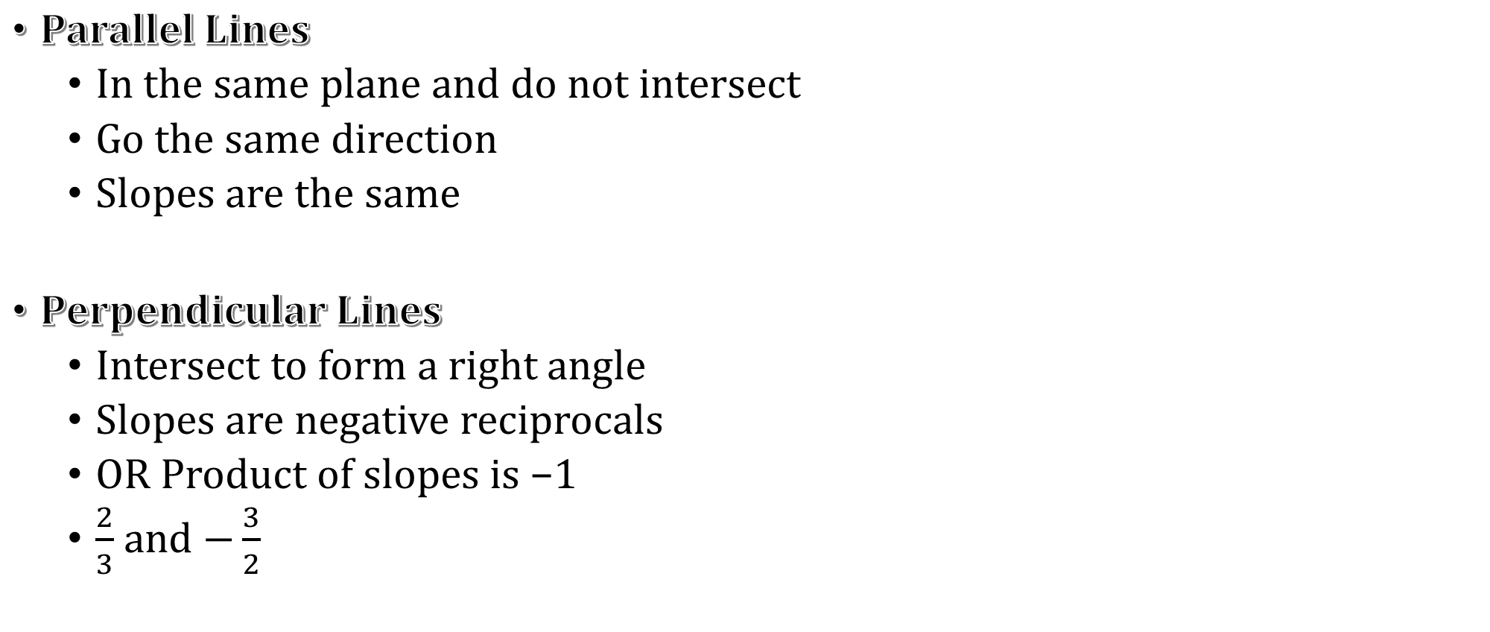
0-04 Find Slope and Write Equations of Lines
Parallel Lines
  In the same plane and do not intersect
  Go the same direction
  Slopes are the same
Perpendicular Lines
  Intersect to form a right angle
  Slopes are negative reciprocals
  OR Product of slopes is −1
  $\frac{2}{3}$ and $−\frac{3}{2}$

Slide 29
0-04 Find Slope and Write Equations of Lines
Tell whether the lines are parallel, perpendicular, or neither.
  Line 1: through (–2, 8) and (2, –4)
  Line 2: through (–5, 1) and (–2, 2)
Notes:
Line 1: $m=\frac{y_{2}−y_{1}}{x_{2}−x_{1}}=\frac{−4 – 8}{2 – \left(−2\right)}=−\frac{12}{4}=−3$
Line 2: $m=\frac{y_{2}−y_{1}}{x_{2}−x_{1}}=\frac{2 – 1}{−2 – \left(−5\right)}=\frac{1}{3}$
Perpendicular

Slide 30
0-04 Find Slope and Write Equations of Lines
Writing Equations of Lines
Given slope and y-intercept
  Use slope-intercept form y = mx + b
Any other line
  Find the slope (m)
  Find a point the line goes through (x₁, y₁)
  Use point-slope form y – y₁ = m(x – x₁)

Slide 31
0-04 Find Slope and Write Equations of Lines
it passes through (–1, 6) and has a slope of 4.
it passes through (−1, 2) and (10, 0)
Notes:
Given slope and point
$$y−y_{1}=m\left(x−x_{1}\right)$$
$$y−6=4\left(x−\left(−1\right)\right)$$
$$y−6=4x+4$$
$$y=4x+10$$
Given two points
$$m=\frac{y_{2}−y_{2}}{x_{2}−x_{1}}=\frac{0 – 2}{10 − \left(−1\right)}=−\frac{2}{11}$$
$$y−y_{1}=m\left(x−x_{1}\right)$$
$$y−0=−\frac{2}{11}\left(x−10\right)$$
$$y=−\frac{2}{11}x+\frac{20}{11}$$

Slide 32
0-04 Find Slope and Write Equations of Lines
In a chemistry experiment, you record the temperature to be −5 °F one minute after you begin. Six minutes after you begin the temperature is 20 °F. Write a linear equation to model this.
Notes:
Two points: (1, -5), (6, 20)
$$m=\frac{y_{2}−y_{1}}{x_{2}−x_{1}}=\frac{20−\left(−5\right)}{6−1}=\frac{25}{5}=5$$
$$y−y_{1}=m\left(x−x_{1}\right)$$
$$y−\left(−5\right)=5\left(x−1\right)$$
$$y+5=5x−5$$
$$y=5x−10$$

Slide 33
0-05 Graph Equations of Lines
Objectives:
Graph equations of lines in slope-intercept form.
Graph equations of lines in standard form.

Slide 34
0-05 Graph Equations of Lines
The simplest way to graph
  Make a table
Choose a reasonable range of x values usually including negatives.
Substitute each x value into the function to find the corresponding y value.
Plot the points on a coordinate plane.
Draw the line through the points.
Notes:
Making a table always works to graph functions

Slide 35

0-05 Graph Equations of Lines
Graph $y=x^{2}−3$
Notes:
Make a table
x -3 -2 -1 0 1 2 3
y 6 1 -2 -3 -2 1 6
Graph the points and draw a curve

Slide 36

0-05 Graph Equations of Lines
Slope-intercept form
  $y=mx+b$
    m is slope
    b is y-intercept
To graph
  Solve equation for y
  Plot the y-intercept
  From there move up and over the slope to find another couple of points
  Draw a line neatly through the points
Notes:
y-intercept is where the line crosses the y-axis

Slide 37
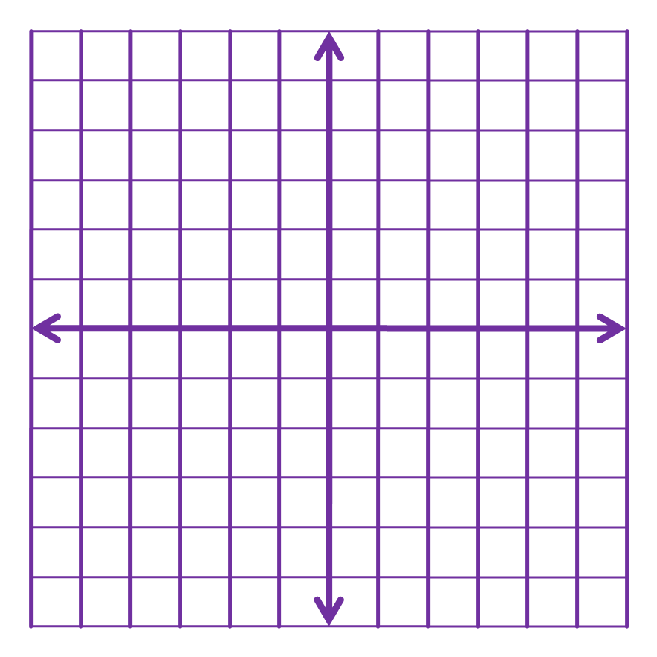

0-05 Graph Equations of Lines
Graph
  $y=−2x$
  $y=x−3$
  $f(x)=2−x$
Notes:
$$y=−2x+0$$
$$m=−2=−\frac{2}{1}; b=0$$
$$y=x−3$$
$$m=1=\frac{1}{1};b=−3$$
$$f\left(x\right)=2−x$$
$$f\left(x\right)=−x+2$$
$$m=−1=−\frac{1}{1};b=2$$

Slide 38

0-05 Graph Equations of Lines
Standard Form
  Ax + By = C
    A, B, and C are integers
To graph
  Find the x- and y-intercepts by letting the other variable = 0
  Plot the two points
  Draw a line through the two points
x-intercept:
Ax + B(0) = C
Ax = C
$x=\frac{C}{A}$
y-intercept:
A(0) + By = C
By = C
$y=\frac{C}{B}$

Slide 39
0-05 Graph Equations of Lines
Horizontal Lines
  y = c
Vertical Lines
  x = c

Slide 40
0-05 Graph Equations of Lines
Graph
  2x + 5y = 10
  x = 1
  y = −4
Notes:
x-int: $2x+5\left(0\right)=10→2x=10→x=5$; (5, 0)
y-int: $2\left(0\right)+5y=10→5y=10→y=2$; (0, 2)
Vertical line
x-int: (1, 0)
Horizontal line
y-int: (0, −4)

Slide 41
0-06 Graph Absolute Value Functions and Transformations
Objectives:
Graph absolute value functions.
Describe transformations of functions.

Slide 42
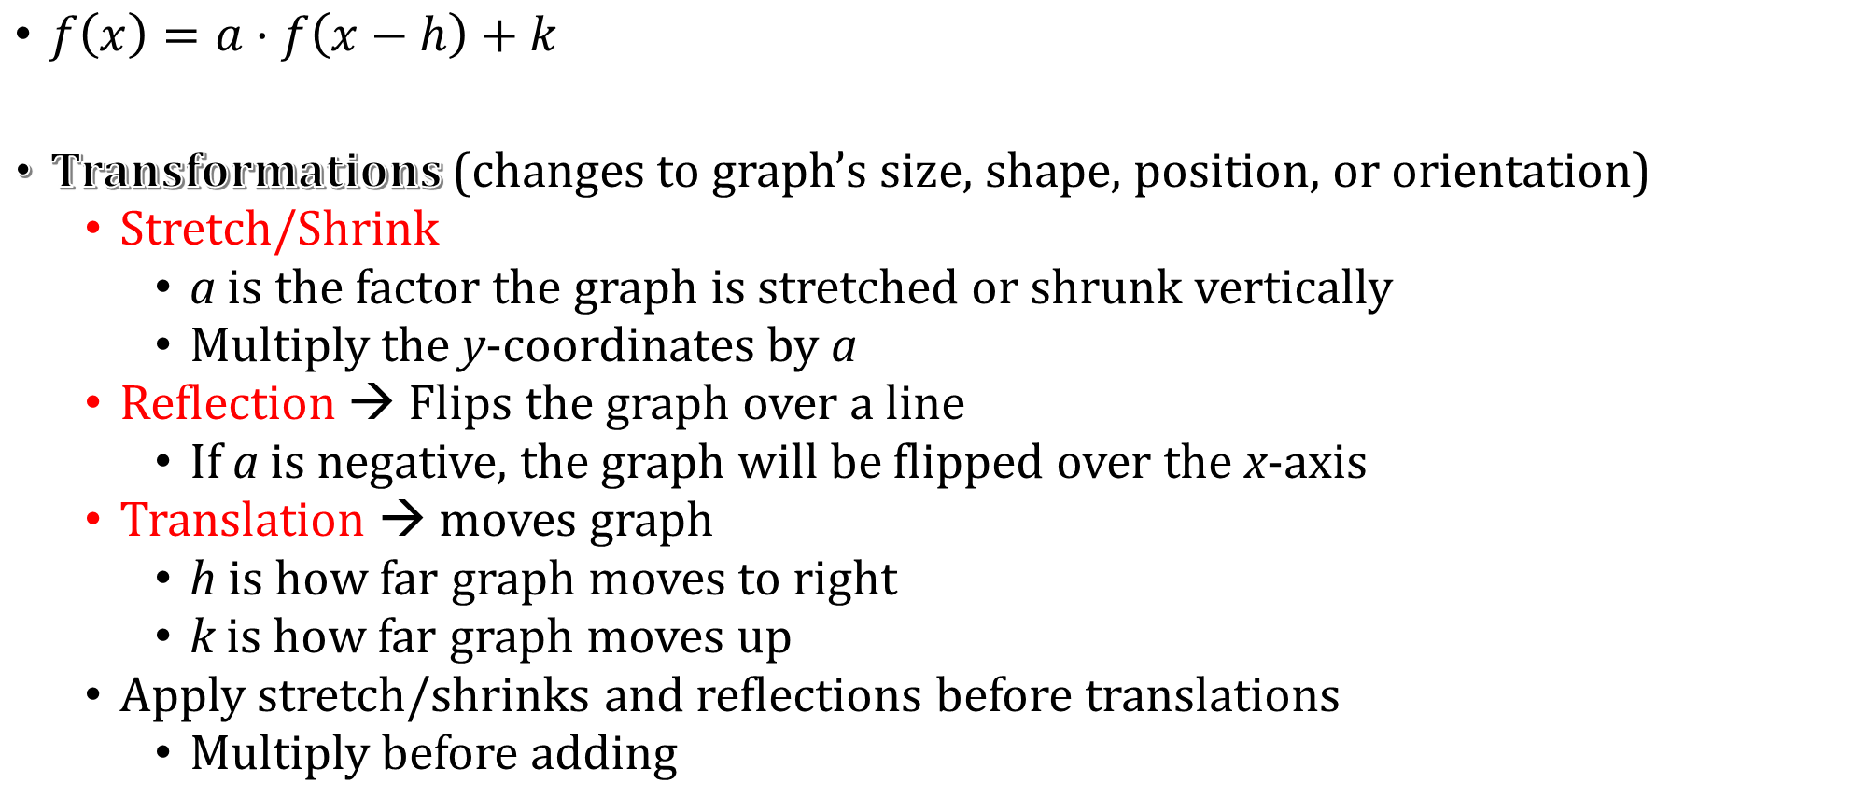
0-06 Graph Absolute Value Functions and Transformations
$f\left(x\right)=a·f\left(x−h\right)+k$
Transformations (changes to graph’s size, shape, position, or orientation)
  Stretch/Shrink
    a is the factor the graph is stretched or shrunk vertically
    Multiply the y-coordinates by a
  Reflection → Flips the graph over a line
    If a is negative, the graph will be flipped over the x-axis
  Translation → moves graph
    h is how far graph moves to right
    k is how far graph moves up
  Apply stretch/shrinks and reflections before translations
    Multiply before adding

Slide 43

0-06 Graph Absolute Value Functions and Transformations
The graph of f(x) is given. Sketch the following functions.
  $y=−\frac{1}{2}f(x)$
Notes:
Reflected over the x-axis because of the -, shrunk vertically by factor of ½ because of the ½.
Reflect the graph over the x-axis first.
Make the distance from each point to the x-axis half the distance.

Slide 44

0-06 Graph Absolute Value Functions and Transformations
The graph of f(x) is given. Sketch the following functions.
  $y=f\left(x−1\right)+3$
Notes:
h = 1 and k = 3, so translated right 1 and up 3.

Slide 45
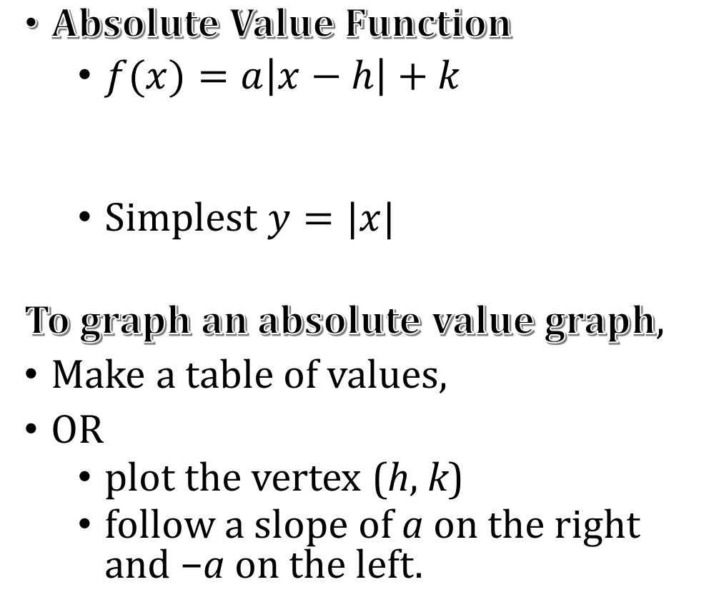
0-06 Graph Absolute Value Functions and Transformations
Absolute Value Function
  $f(x)=a\left|x−h\right|+k$
  Simplest $y=|x|$
To graph an absolute value graph,
Make a table of values,
OR
  plot the vertex (h, k)
  follow a slope of a on the right and −a on the left.
Slope of left is −1
Vertex
Slope of right is 1

Slide 46

0-06 Graph Absolute Value Functions and Transformations
Graph and compare with y = |x|
  $y=\left|x−2\right|+3$
Notes:
$$y=a\left|x−h\right|+k$$
$$y=\left|x−2\right|+3$$
h = 2, k = 3
Translated 2 right and 3 up. The vertex will be (h, k) = (2, 3)
a = 1
The slope of the right side will be 1. (Translated 2 right and 3 up.)

Slide 47

0-06 Graph Absolute Value Functions and Transformations
Graph and compare with y = |x|
  $y=\frac{1}{4}|x|$
Notes:
$$y=a\left|x−h\right|+k$$
$$y=\frac{1}{4}\left|x\right|$$
h = 0, k = 0 since they are missing
Not translated. The vertex will be (h, k) = (0, 0)
$a=\frac{1}{4}$
The slope of the right side will be 1/4. (Shrunk vertically by factor of ¼.)

Slide 48

0-06 Graph Absolute Value Functions and Transformations
Graph and compare with y = |x|
  $y=−3|x+1|−2$
Notes:
$$y=a\left|x−h\right|+k$$
$$y=−3\left|x+1\right|−2$$
h = -1, k = -2
Translated 1 left and 2 down. The vertex will be (h, k) = (-1, -2)
a = -3
The slope of the right side will be -3. (Reflected over the x-axis, stretched by factor of 3, translated 1 left and 2 down.)

Slide 49
0-06 Graph Absolute Value Functions and Transformations
Write an absolute value equation for the given graph.
Notes:
Vertex is at (-3, 5), so h = -3 and k = 5.
The slope of the right side is $−\frac{5}{1}=−5$, so a = -5
$$y=a\left|x−h\right|+k$$
$$y=−5 \left|x+3\right|+5$$

Slide 50
0-07 Graph Linear Inequalities
Objectives:
Determine whether an ordered pair is a solution to an inequality in two variables.
Graph a linear inequality in two variables.

Slide 51
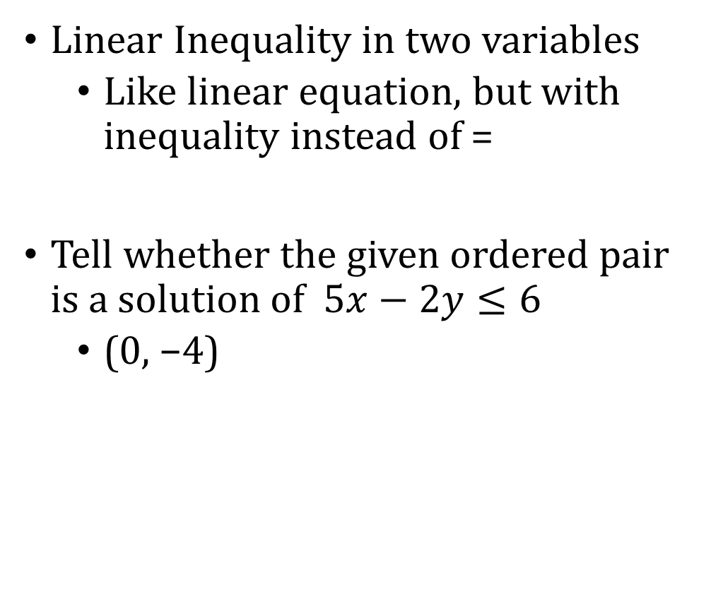
0-07 Graph Linear Inequalities
Linear Inequality in two variables
  Like linear equation, but with inequality instead of =
Tell whether the given ordered pair is a solution of $5x−2y≤6$
  (0, −4)
  (−3, 8)
Notes:
$$5x−2y≤6$$
$$5\left(0\right)−2\left(−4\right)≤6$$
$$8≤6$$
Not true, so not a solution
$$5x−2y≤6$$
$$5\left(−3\right)−2\left(8\right)≤6$$
$$−15−16≤6$$
$$−31≤6$$
True, so it is a solution

Slide 52
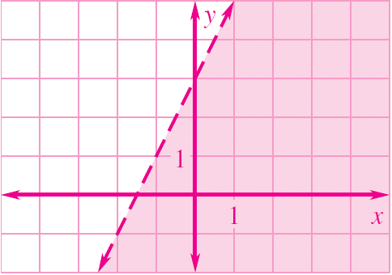
0-07 Graph Linear Inequalities
Graphing a linear inequality
  Graph the line as if it was =
  Dotted or Solid line
    Dotted if <, >
    Solid if ≤, =, ≥
  Shade
    Test a point not on the line
    If the point is a solution, shade that side of the line
    If the point is not a solution, shade the other side of the line

Slide 53
0-07 Graph Linear Inequalities
Graph
  x ≥ −4
Notes:
Graph the line: Vertical line at x = −4.
Solid because equal to.
Shade the right because that is where the x’s are bigger than −4.

Slide 54
0-07 Graph Linear Inequalities
Graph
  y > −3x
Notes:
Graph line: y-int = 0, slope = −3.
Dotted because not equal to.
Pick (1, 0) as test point. $y>−3x→0>−3\left(1\right)→0>−3$. This is true so shade that side of the line.

Slide 55
0-07 Graph Linear Inequalities
Graph
  y ≤ 2x + 3
Notes:
Graph the line: y-int = 3, slope = 2.
Solid because equal to.
Pick (0, 0) as test point. $y≤2x+3→0≤2\left(0\right)+3→0≤3$. This is true so shade that side of the line.

Slide 56
0-07 Graph Linear Inequalities
Graph
  y < 3|x – 1| – 3
Notes:
Graph the absolute value: h = 1, k = −3, a = 3
Dotted because not equal to.
Pick (1, 0) as test point. $y<3\left|x−1\right|−3→0<3\left|1−1\right|−3→0<−3$. This is false so shade the other side of the line.

Slide 57
0-07 Graph Linear Inequalities
You have two part-time summer jobs, one that pays $9 an hour and another that pays $12 an hour. You would like to earn at least $240 a week. Write an inequality describing the possible amounts of time you can schedule at both jobs.
Notes:
Rate problem: rate × amount = total
$$9x+12y≥240$$
Greater than sign because the 240 is the smallest we want, so the small side of the sign is pointed at 240.

Slide 58
0-07 Graph Linear Inequalities
0 2 4 6 8 10 12 14 16 18 20 22 24
Graph the previous answer
Identify three possible solutions of the inequality
0 3 6 9 12 15 18 21 24 27 30 33 36
Notes:
$$9x+12y≥240$$
Graph the line: This is in standard form, so find the intercepts.
x-int: $9x+12\left(0\right)=240→x≈26.7$
y-int: $9\left(0\right)+12y=240→y=20$
Solid line because equal to.
Test (0, 0). $9x+12y≥0→9\left(0\right)+12\left(0\right)≥240→0≥240$. This is false, so shade the other side of the line.
Pick any three points in the shaded area.
Sample Answers: (15, 12), (24, 4), (3, 20)

Slide 59
0-08 Draw Scatter Plots and Best-Fitting Lines
Objectives:
Determine whether how well data fits a linear relationship.
Find the equation of the best-fitting line given a set of data.

Slide 60
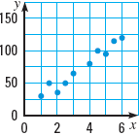
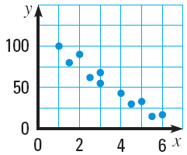
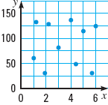
0-08 Draw Scatter Plots and Best-Fitting Lines
Scatter Plot
  Graph of many data points
Positive Correlation
  The slope of the scatter plot tends to be positive
Negative Correlation
  The slope of the scatter plot tends to be negative
No Correlation
  There is no obvious pattern from the scatter plot

Slide 61
0-08 Draw Scatter Plots and Best-Fitting Lines
Correlation Coefficient (r)
  Number between −1 and 1 that measures how well the data fits a line.
  Positive for positive correlation, negative for negative
  r = 0 means there is no correlation

Slide 62
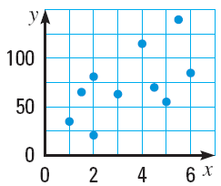
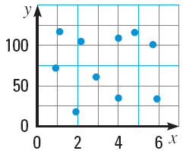
0-08 Draw Scatter Plots and Best-Fitting Lines
For each scatter plot, (a) tell whether the data have a positive correlation, a negative correlation, or approximately no correlation, and (b) tell whether the correlation coefficient is closest to –1, –0.5, 0, 0.5, or 1.
Notes:
Positive, r ≈ 0.5
Negative, r ≈ −1
No correlation, r ≈ 0

Slide 63
0-08 Draw Scatter Plots and Best-Fitting Lines
Best-fitting line
  Line that most closely approximates the data
Find the best-fitting line
  Draw a scatter plot of the data
  Sketch the line that appears to follow the data the closest
    There should be about as many points below the line as above
  Choose two points on the line and find the equation of the line
    These do not have to be original data points
Notes:
See example 4 in the textbook to see how to do this on a TI graphing calculator

Slide 64
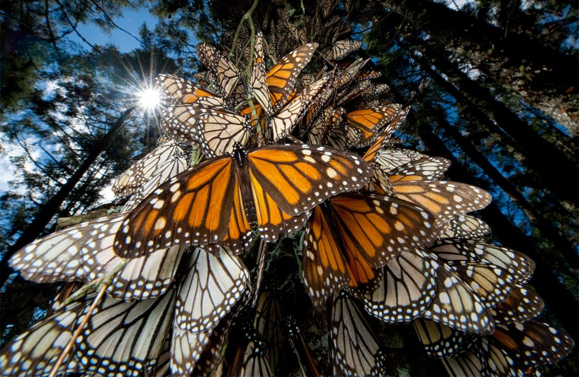
0-08 Draw Scatter Plots and Best-Fitting Lines
Monarch Butterflies: The table shows the area in Mexico used by Monarch Butterflies to spend winter, y, in acres x years after 2006.
  Approximate the best-fitting line for the data.
  Use your equation from part (a) to predict the area used by the butterflies in 2016.
x | 0 | 1 | 2 | 3 | 4 | 5 | 6 | 7
y | 16.5 | 11.4 | 12.5 | 4.7 | 9.9 | 7.1 | 2.9 | 1.7
Notes:
Sample Answer: $y=−1.89x+14.97$
Sample Answer:
$y=−1.89(10)+14.97=−3.93$acres (they would be gone, extinct!)

Slide 65
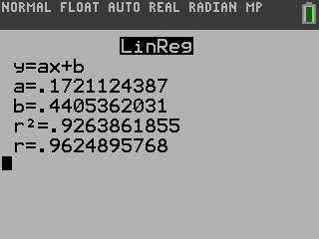
0-08 Draw Scatter Plots and Best-Fitting Lines
Finding Linear Regression on a TI-84
Push STAT and select Edit….
Enter the x-values in List 1 (L1) and the y-values in List 2 (L2).
To see the graph of the points
  Push Y= and clear any equations.
  While still in Y=, go up and highlight Plot1 and press ENTER.
  Press ZOOM and select ZoomStat.
Push STAT and move over to the CALC menu.
Select LinReg(ax+b) (Linear Regression).
Make sure the Xlist: is L1,the Ylist: is L1, the FreqList: is blank, and the Store RegEQ: is Y1.
  Get Y1 by pressing VARS and select Y-VARS menu.
  Select Function….
  Select Y1.
Press Calculate
The calculator will display the equation. To see the graph of the points and line, press GRAPH.
Notes:
Note: Older TI graphing calculators do not have the screen in steps 6 and 7. After selecting the LinReg(ax+b), the screen just shows "LinReg(ax+b)". Press ENTER again to see the result. To see the graph, enter the equation into the Y= screen and press GRAPH.

Slide 66
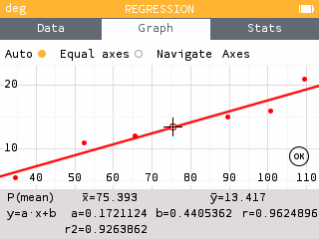
0-08 Draw Scatter Plots and Best-Fitting Lines
Finding Linear Regression on a NumWorks graphing calculator
On the home screen select Regression.
In the Data tab, enter the points.
Move to the Graph tab.
The default is a linear regression and is displayed at the bottom of the screen. To change the regression type
  Press OK.
  Select Regression.
  Select the desired regression type

